Slide 1
Tree Diagrams Probability Lesson 3
Year 9

Slide 2
24
7
30
Topic: Tree Diagrams
Date:
EQ – How can we show two step problems with tree diagrams?
What is a tree diagram?
Tree diagrams are a way of writing the sample space for a particular event.
For a coin toss we can have a heads or a tails. What happens if we toss two coins?

Slide 3
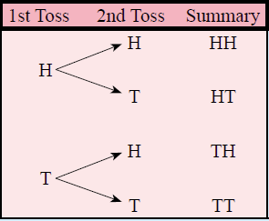

24
7
30
Topic: Tree Diagrams
Date:
EQ – How can we show two step problems with tree diagrams?
What is a tree diagram?
Tree diagrams are another useful way of creating representations of multi step events. Each outcome is represented on a “branch”
For a coin toss we can have a heads or a tails. What happens if we toss two coins?

Slide 4
24
7
30
Topic: Tree Diagrams
Date:
EQ – How can we show two step problems with tree diagrams?
What is a tree diagram?
Tree diagrams are another useful way of creating representations of multi step events. Each outcome is represented on a “branch”
For a coin toss we can have a heads or a tails. What happens if we toss two coins?

Slide 5
24
7
30
Topic: Tree Diagrams
Date:
EQ – How can we show two step problems with tree diagrams?
What is a tree diagram?
Tree diagrams are another useful way of creating representations of multi step events. Each outcome is represented on a “branch”
For a coin toss we can have a heads or a tails. What happens if we toss two coins?
4 outcomes
Heads then Heads = 0.25
Heads then Tails = 0.25
Tails then Heads = 0.25
Tails then Tails = 0.25
What is the probability of getting one of these outcomes?

Slide 6


Slide 7
Activity
You will be given a spot to stand in the room
You need to work out why you are standing there
Notes:
Dark hair, not dark hair
Short hair, long hair
Alternatives: boy / girl, shorts/pants

Slide 8
Short hair
Long hair
5

Slide 9
Light hair
Short and Light hair
Short hair
Dark hair
Short and Dark hair
Light hair
Long and Light hair
Long hair
Dark hair
Long and Dark hair
5

Slide 10
Light hair
Short and Light hair
Short hair
Dark hair
Short and Dark hair
Light hair
Long and Light hair
Long hair
Dark hair
Long and Dark hair
5

Slide 11
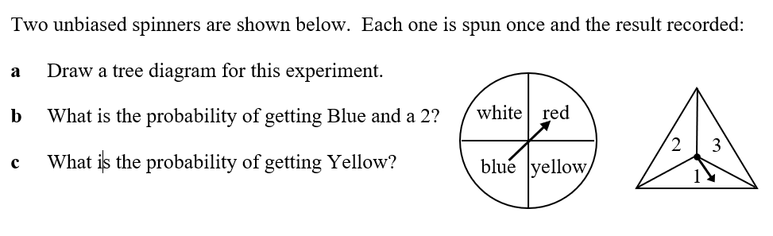

Worked Example
White
Red
Blue
Yellow
1
2
3
1
2
3
1
2
3
1
2
3
W1
W2
W3
R1
R2
R3
B1
B2
B3
Y2
Y2
Y3
$$\frac{1}{12}$$
P (Blue and 2) =
P(Yellow) =
$$\frac{1}{4}$$

Slide 12
